Slide 1





Consumer Ad-Hoc Goods Insight
Presented By :- Naveen Jhinjarye
SQL Project Challenge

Slide 2


Atliq Hardware Background
Project Statement & Project Objective
AGENDA
Database Overview
Getting Familiar with Atliq’s Product lines and customer Segmentation
Ad-Hoc requests along with the queried results, visualization and insights

Slide 3

ATLIQ
HARWARES
Atliq Hardwares is a leading computer hardware company specializing in PCs, accessories, and networking products.
The company operates across four major regions: APAC, EU, LATAM, and North America.

Slide 4

Problem Statement
Company has large sales data but lacks clear insights
Decision-making is slow due to no proper data analysis
Need to convert raw data into actionable business insights

Slide 5



Project
Objective
Analyze sales data using SQL
Identify key business trends
Generate actionable insights
Support data-driven decision making

Slide 6


Database Overview
dim_date
dim_customer
fact_sales_monthly
fact_gross_price, fact_manufacturing_cost fact_pre_invoice_deductions
Contains customer, product, and sales data
Uses fact and dimension tables
Data is connected using keys (product_code, customer_code)
Helps in analyzing sales and business performance
Currency Stability
Fiscal Year
September To August
21%
Economic Growth

Slide 7
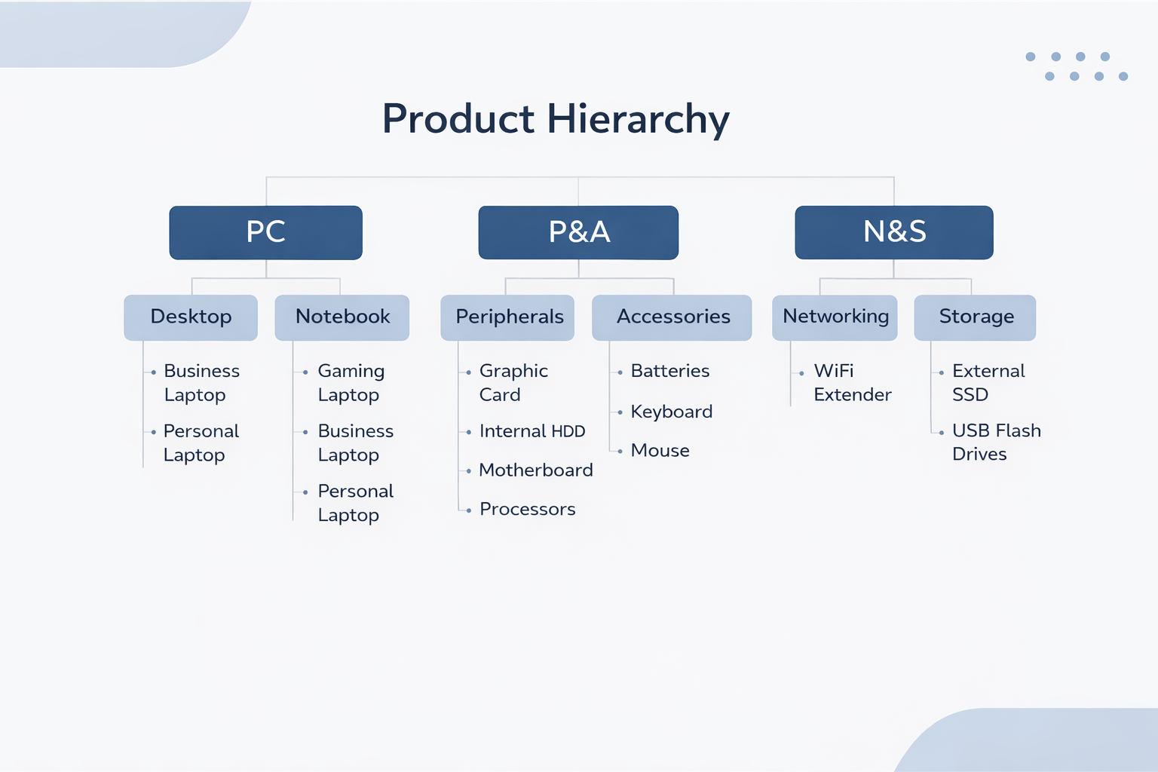
Economic Growth

Slide 8
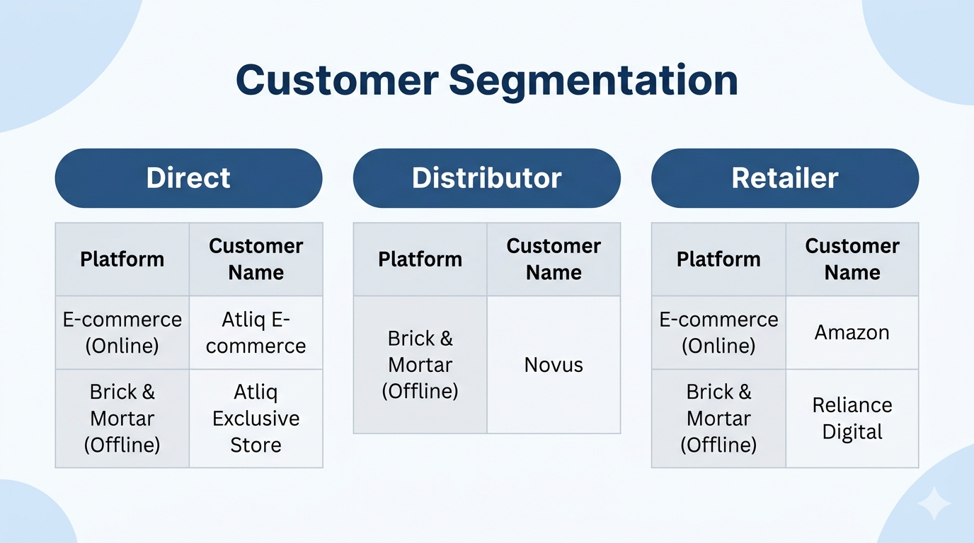

Slide 9
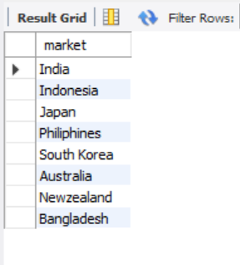

Provide the list of markets in which customer "Atliq Exclusive" operates its business in the APAC region.
select distinct market
from dim_customer
where customer = "Atliq Exclusive" and region = "APAC";

Slide 10
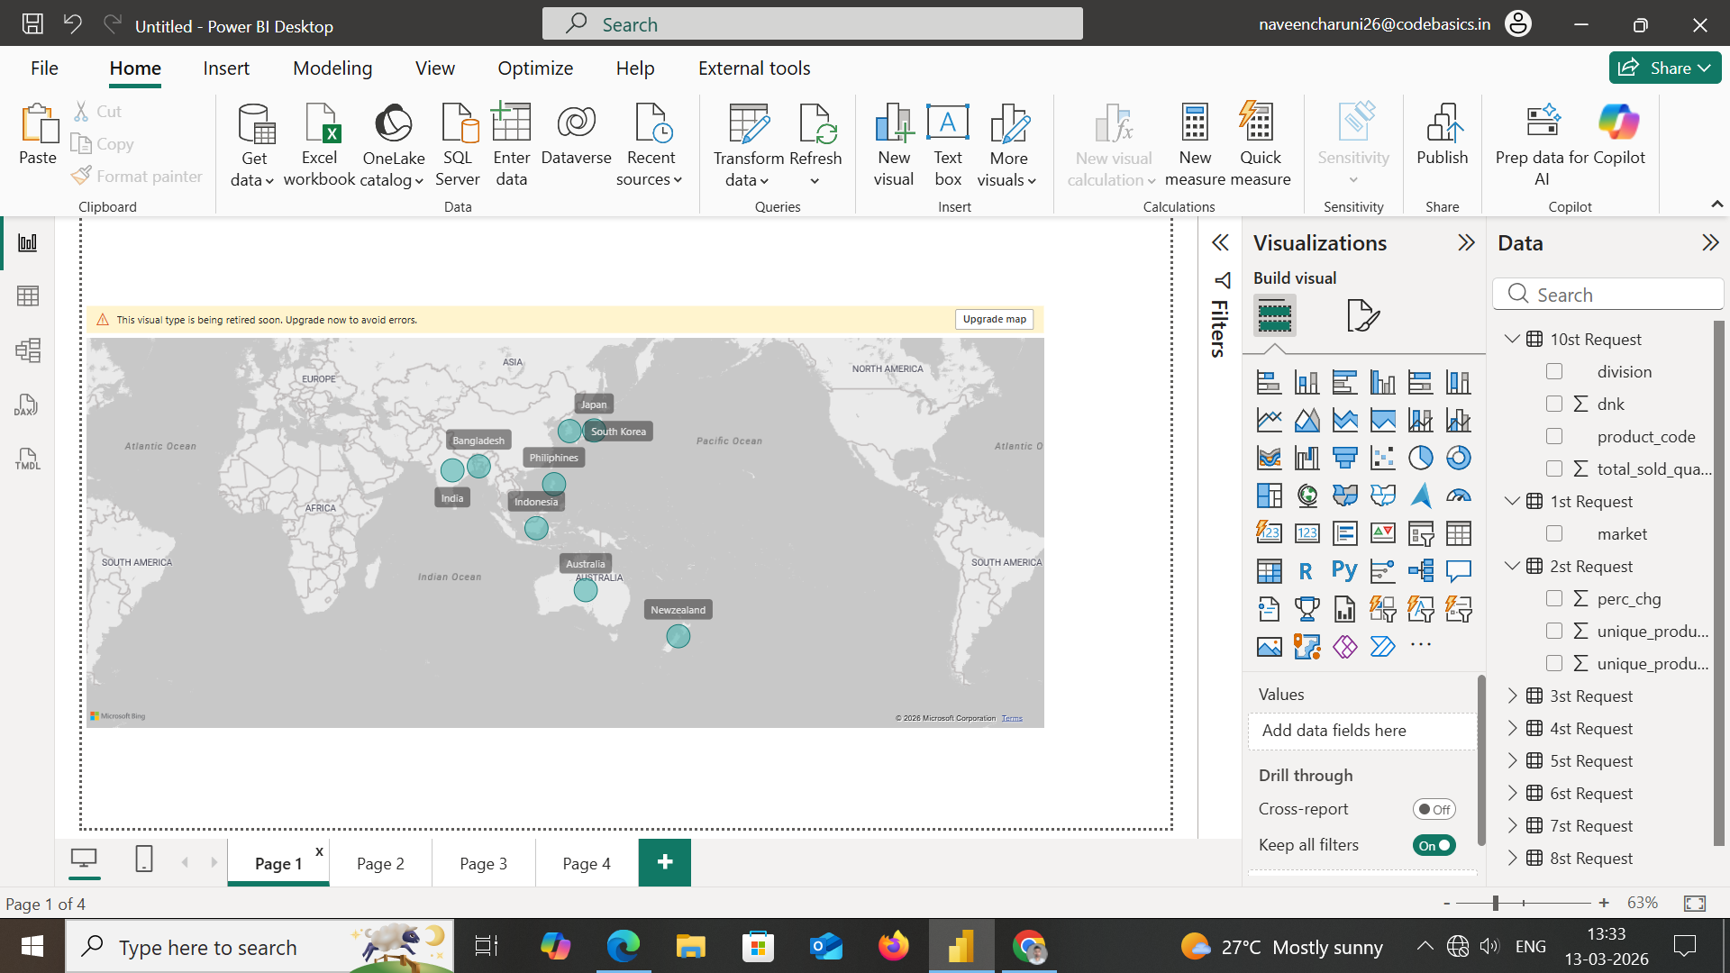

Atliq Exclusive operates in 7 markets across the APAC region.

Slide 11
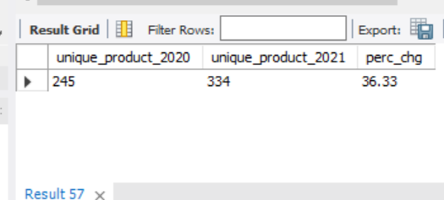
What is the percentage of unique product increase in 2021 vs. 2020? The final output contains these fields
unique_products_2020 unique_products_2021
percentage_chg
with unique_product_table as (SELECT
count(case when fiscal_year = '2020' then product end) as unique_product_2020,
count(case when fiscal_year = '2021' then product end) as unique_product_2021
FROM dim_product d
join fact_gross_price f on f.product_code = d.product_code)
select *,
round((unique_product_2021 - unique_product_2020)/unique_product_2020*100,2) as perc_chg
from unique_product_table;

Slide 12
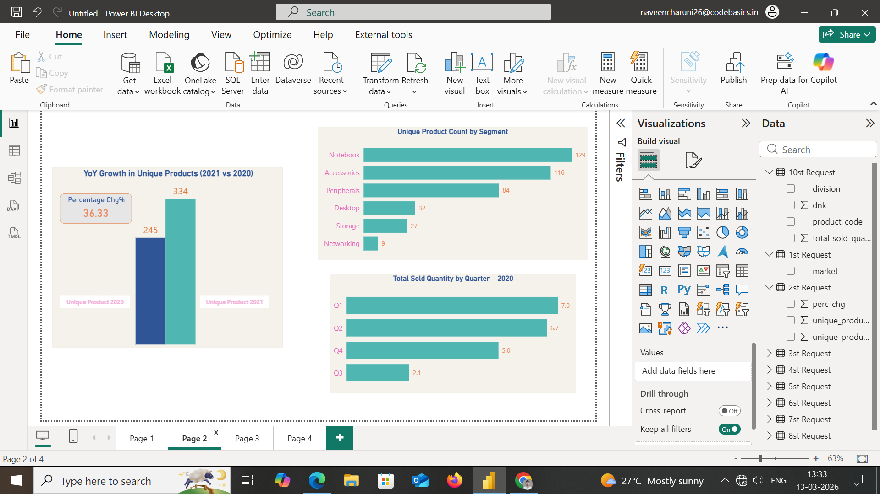
I observed a 36% increase in unique products in 2021, showing strong expansion in Atliq’s product

Slide 13
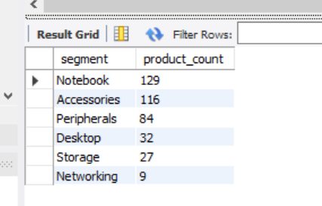
Provide a report with all the unique product counts for each segment and sort them in descending order of product counts. The final output contains 2 fields,
segment
product_count
select segment , count(product) as product_count
from dim_product
group by segment
order by product_count desc;

Slide 14
Higher product variety in key segments indicates strong focus and opportunity for targeted strategies.

Slide 15
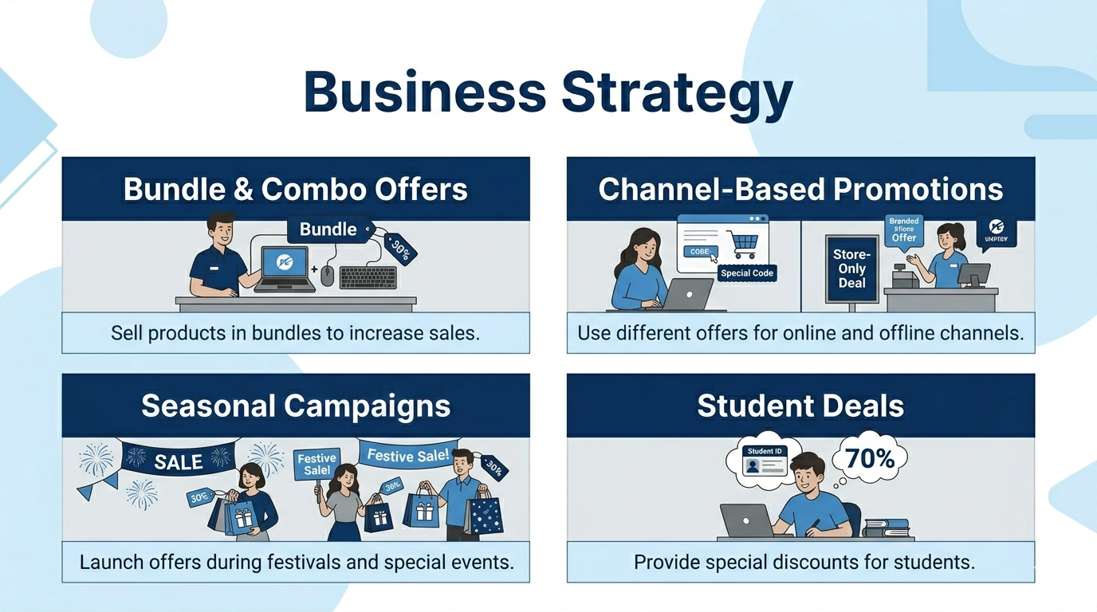

Slide 16
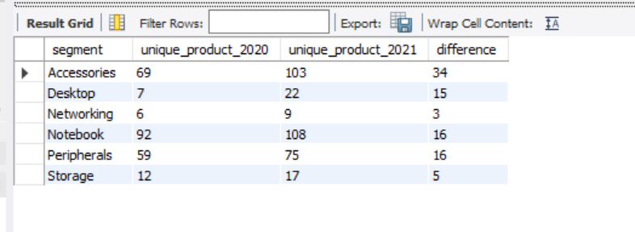
Which segment had the most increase in unique products in 2021 vs 2020? The final output contains these fields,
segment
product_count_2020 product_count_2021
difference
with uni_pro_tab as (SELECT segment,
count(case when fiscal_year = '2020' then product end) as unique_product_2020,
count(case when fiscal_year = '2021' then product end) as unique_product_2021
FROM dim_product d
join fact_gross_price f on f.product_code = d.product_code
group by segment)
select *,
unique_product_2021 - unique_product_2020 as difference
from uni_pro_tab
order by segment asc ,difference desc;
In 2021, the highest increase in unique products was observed in Accessories, Notebook, and Peripherals segments.

Slide 17
Get the products that have the highest and lowest manufacturing costs. The final output should contain these fields
product_code
product
manufacturing_cost
select p.product_code,p.product,manufacturing_cost
from fact_manufacturing_cost m
join dim_product p on p.product_code = m.product_code
where manufacturing_cost in ((select max(manufacturing_cost)from fact_manufacturing_cost),
(select min(manufacturing_cost)from fact_manufacturing_cost));

Slide 18
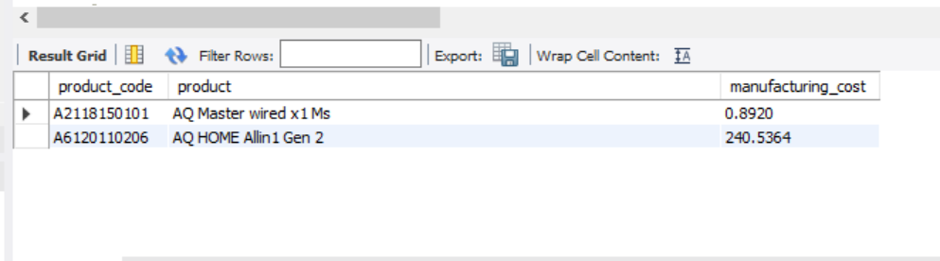



Low-cost accessories can be used to enhance the value of high-cost products through bundling.
AQ HOME Allin1 Gen 2
AQ Master wired x1 Ms

Slide 19
Generate a report which contains the top 5 customers who received an average high pre_invoice_discount_pct for the fiscal year 2021 and in the Indian market. The final output contains these fields, customer_code
customer
average_discount_percentage
select c.customer_code ,c.customer,f.pre_invoice_discount_pct as average_discount_percentage
from fact_pre_invoice_deductions f
join dim_customer c on c.customer_code = f.customer_code
where f.fiscal_year = '2021' and c.market = 'india'
and pre_invoice_discount_pct > (select avg(pre_invoice_discount_pct)
from fact_pre_invoice_deductions )
order by average_discount_percentage desc
limit 5 ;

Slide 20
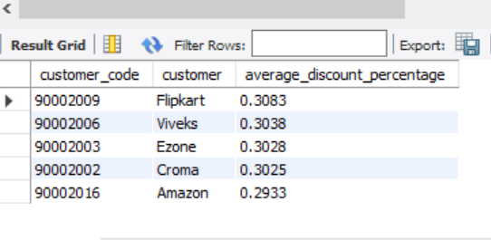
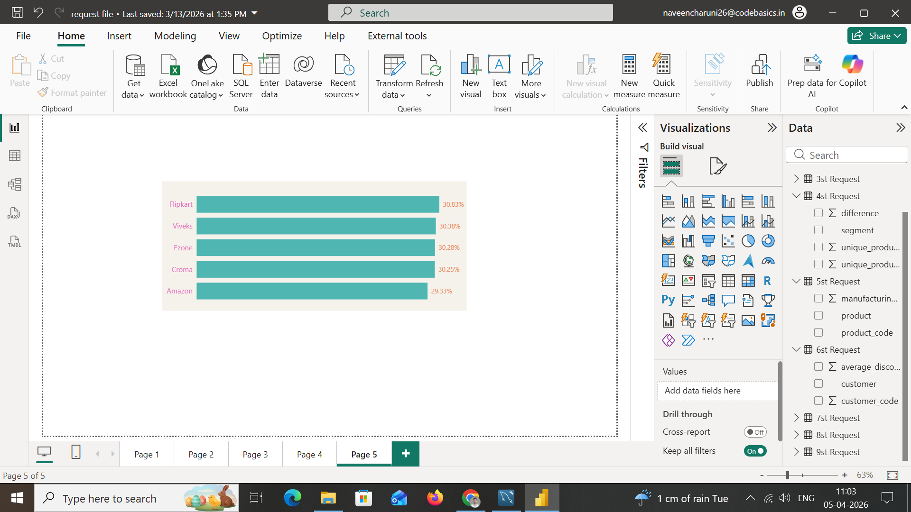
In 2021, Atliq provided the highest average pre-invoice discount to its top 5 customers, with Flipkart receiving the highest discount at 30.83%.

Slide 21
Get the complete report of the Gross sales amount for the customer “Atliq Exclusive” for each month . This analysis helps to get an idea of low and high-performing months and take strategic decisions. The final report contains these columns: Month
Year
Gross sales Amount
select monthname(date_add(m.date ,interval 4 month)) as month_n,
m.fiscal_year as year,
Round(sum(gross_price*sold_quantity)/1000000,2) as Gross_sales
from fact_sales_monthly m
join fact_gross_price g
on m.product_code = g.product_code
join dim_customer c on c.customer_code = m.customer_code
where c.customer = 'Atliq Exclusive'
group by m.date, year
order by month_n,year;

Slide 22
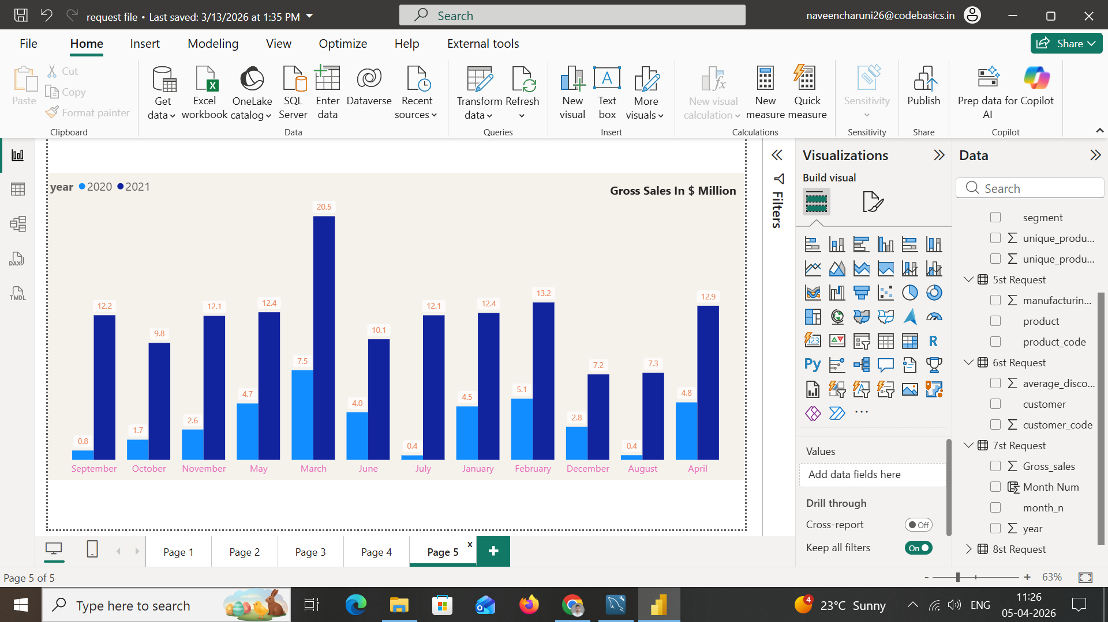
2021 shows higher sales than 2020 across every month

Slide 23
In which quarter of 2020, got the maximum total_sold_quantity? The final output contains these fields sorted by the total_sold_quantity.
Quarter ,
total_sold_quantity
select
concat("Q",quarter(date_add(date,interval 4 month)))as quarter_c,
round(sum(sold_quantity)/1000000,2) as total_sold_quantity
from fact_sales_monthly f
where fiscal_year = 2020
group by quarter_c
order by total_sold_quantity Desc;

Slide 24
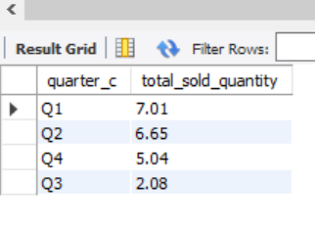
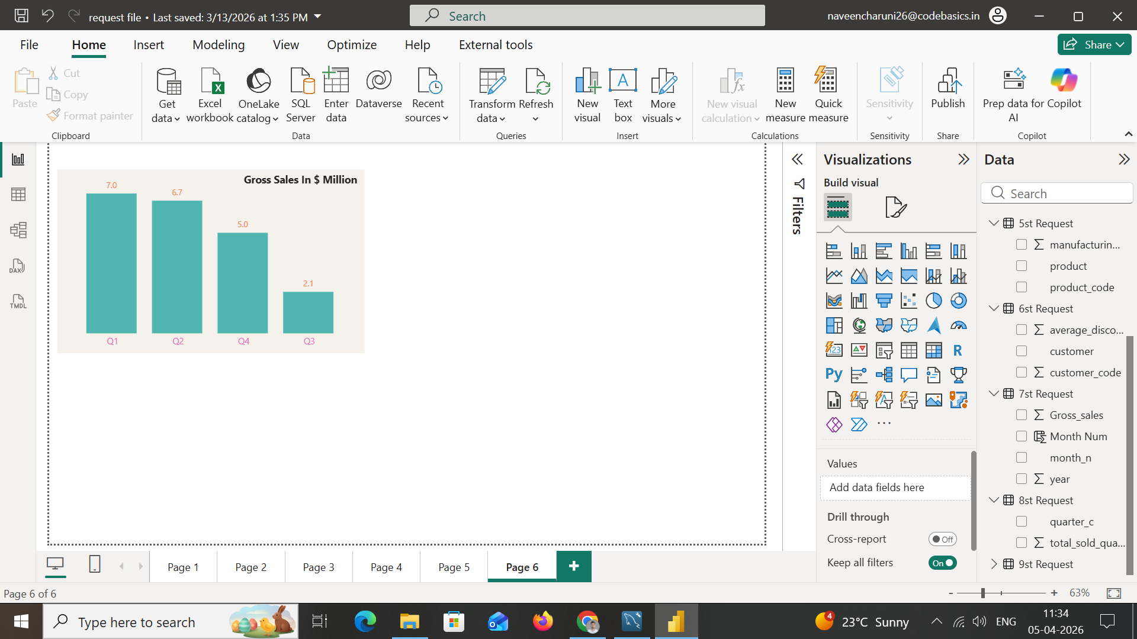
Sales in 2020 were impacted by the COVID-19 pandemic, with variations across quarters due to lockdowns and market disruptions.

Slide 25
Which channel helped to bring more gross sales in the fiscal year 2021 and the percentage of contribution? The final output contains these fields, channel gross_sales_mln
percentage
with gross_table as (select c.channel,
round(sum(gross_price* sold_quantity)/1000000,2) as gross_sales_mln
from fact_sales_monthly f
join fact_gross_price g
on g.product_code = f.product_code and f.fiscal_year = g.fiscal_year
join dim_customer c
on f.customer_code = c.customer_code
where f.fiscal_year = 2021
group by c.channel)
select *,
round(gross_sales_mln*100 /sum(gross_sales_mln) over(),2) as perc_contri
from gross_table
order by gross_sales_mln desc;

Slide 26
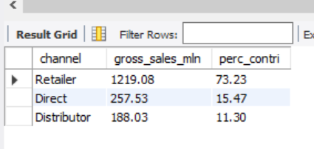
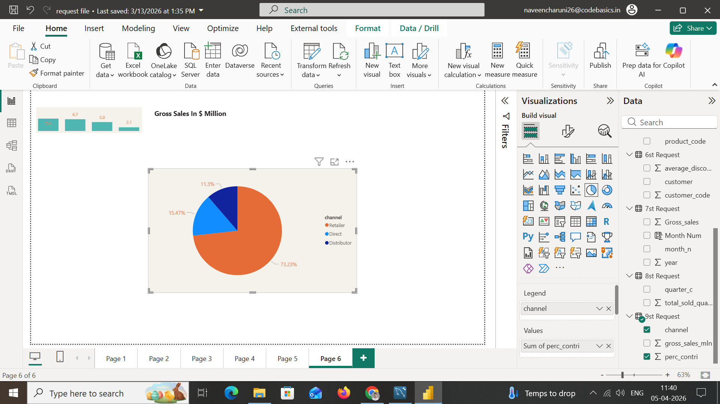
Retailer channel contributed the highest gross sales in 2021, accounting for 73.23% of total revenue.

Slide 27
Get the Top 3 products in each division that have a high total_sold_quantity in the fiscal_year 2021? The final output contains these fields,
division
product_code ,
Product ,
total_sold_quantity ,
rank_order
with product_t as (select division,p.product_code,
sum(sold_quantity) as total_sold_quantity
from fact_sales_monthly f
join fact_gross_price g
on f.product_code = g.product_code and g.fiscal_year = f.fiscal_year
join dim_product p
on f.product_code = p.product_code
where f.fiscal_year = 2021
group by division , product_code),drnk_table as
(select *, dense_rank() over(partition by division order by total_sold_quantity desc) as dnk
from product_t)
select * from drnk_table where dnk <=3;

Slide 28
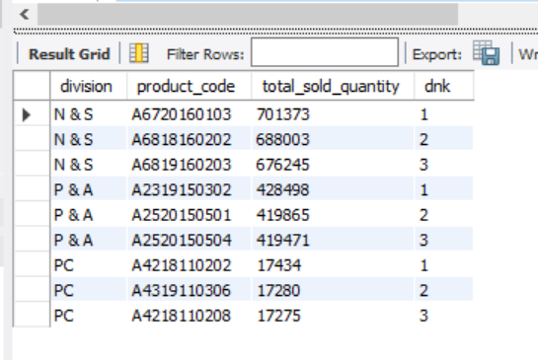

Slide 29
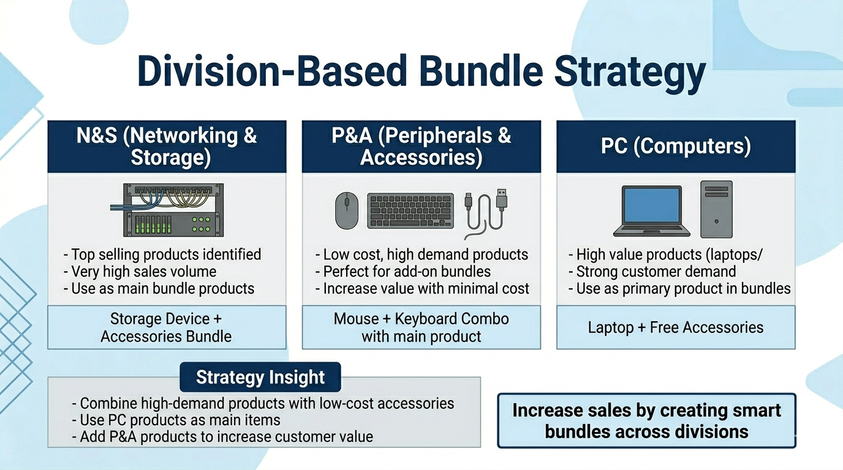

Slide 30



Thank you
My Gmail
naveencharuni26@gmail.com
Linkedin ID
Naveen Jhinjarye

